Slide 1
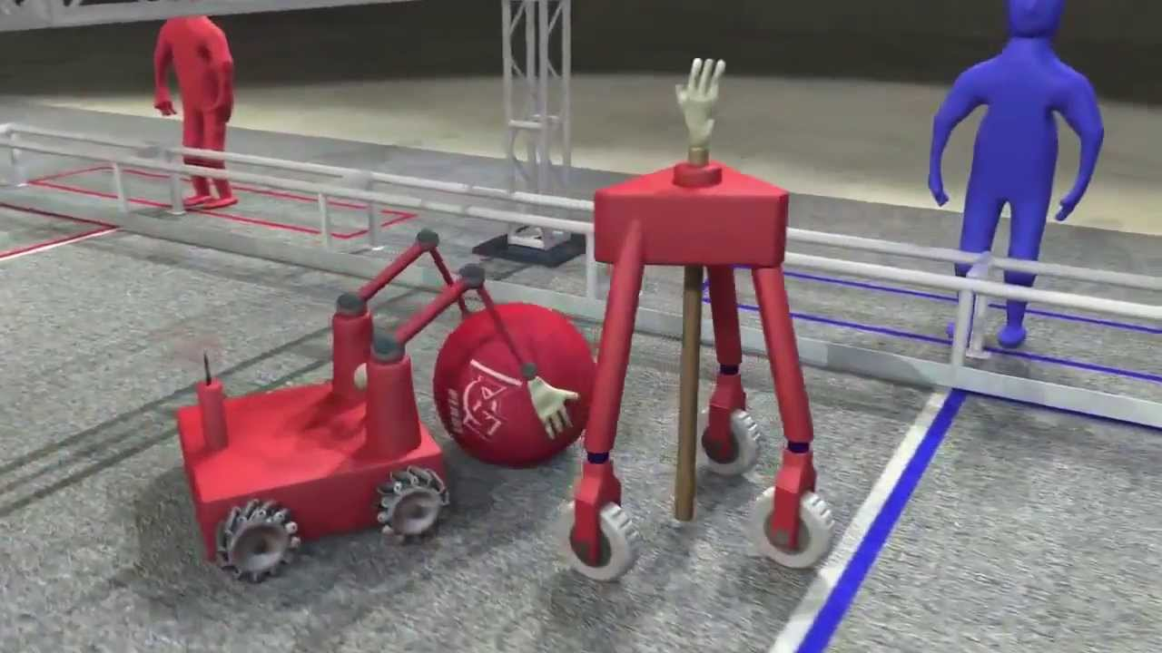
Mechanism Design
Collectors - Manipulators - Shooters

Slide 2
Roller Collectors
Lucien Junkin - 118

Slide 3
Robonauts Intake Philosophy
Touch It .......... Own It
We strive to control the game piece as soon as we touch the game piece with the robot
Prototype ..... Prototype ..... Prototype
We start with very, very quick prototypes and end with prototypes that have all of the features that our “flight” robot will have
We have zillions of “Come Check This Out” moments
We prototype throughout the season to tweak our intake
We meld as a subsystem and team through prototyping
The design & manufacturing is the “easy part” ....... albeit very, very time consuming

Slide 4
Robonauts Prototyping ... “The Fun Part”
“Come Check This Out” Moments
In the beginning, we prototype in minutes ..... not hours
In the end, we prototype in hours ..... not minutes
We have “3 minute brainstorming” sessions around our prototypes to determine our next prototype
Eventually one of these moments becomes the “AHA” moment
We continue to refine and test the design throughout the year

Slide 5
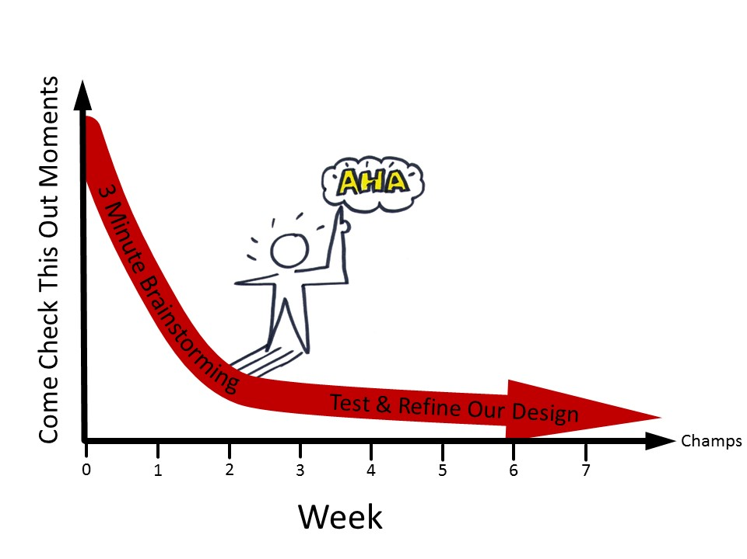
Robonauts Prototyping

Slide 6
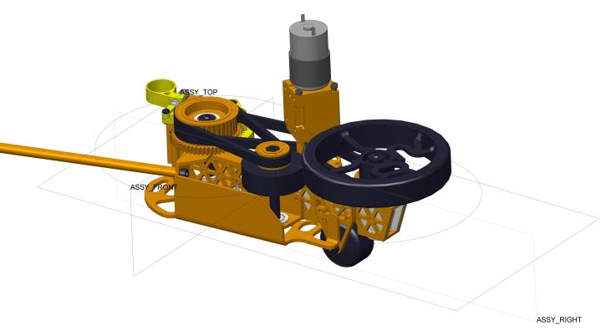
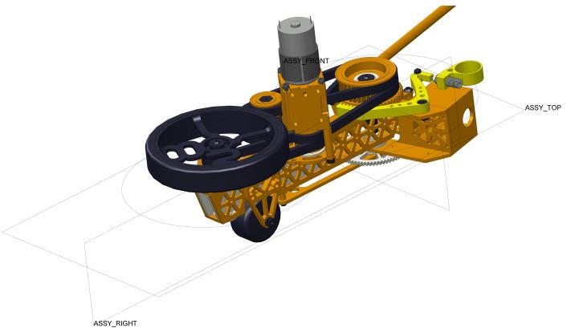
Robonauts Design ... “The Easy Part”
Design
ProE & lots of hours

Slide 7
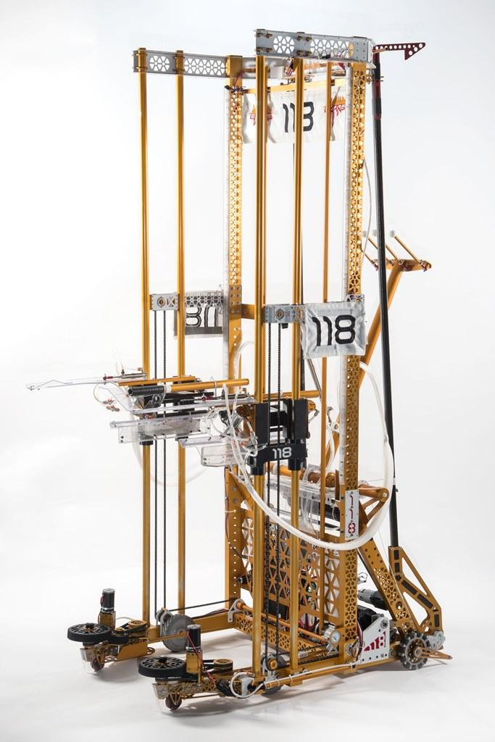
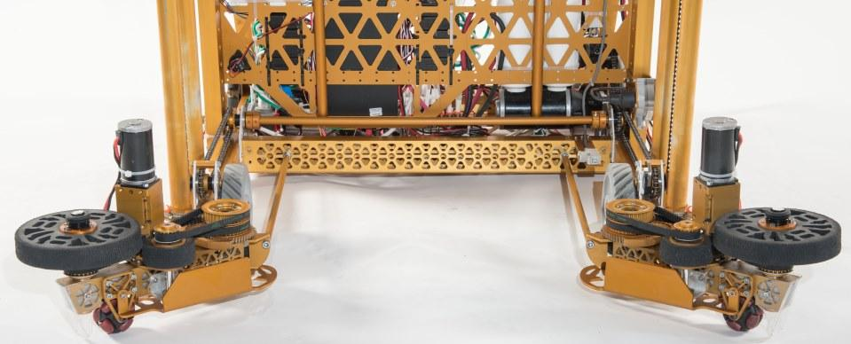
Robonauts Make ... “The Easy Part … Part 2”
Make
Manufacturing machines & lots of hours

Slide 8
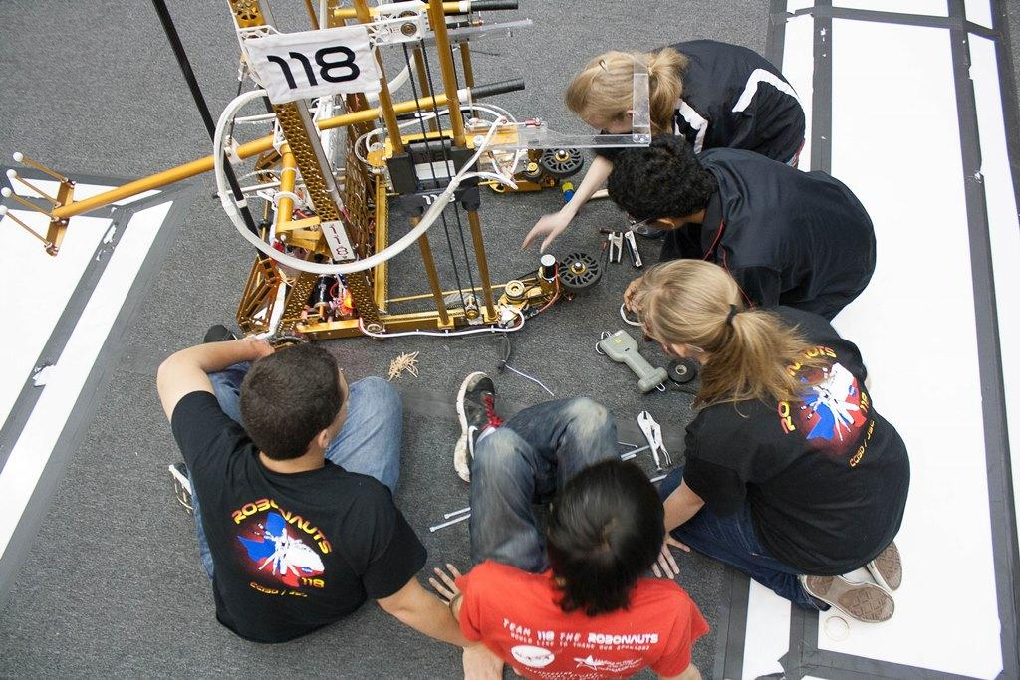
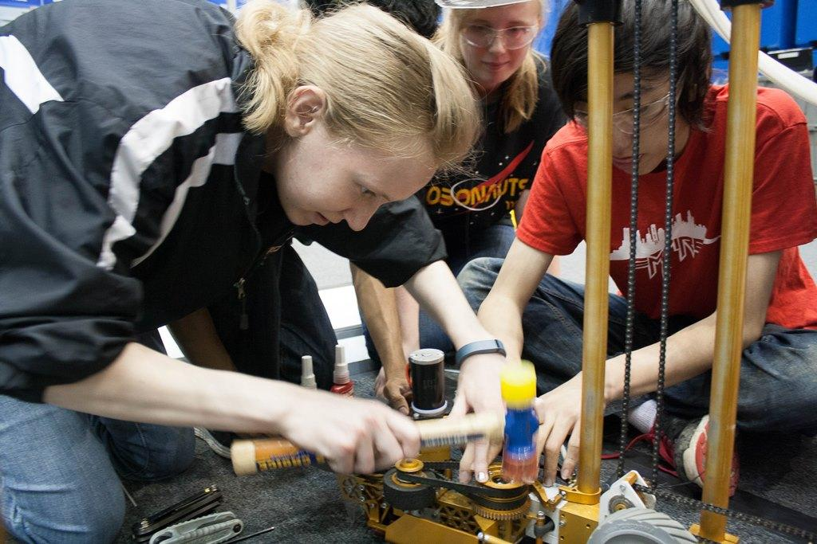
Robonauts Test & Maintain ... “The Hard Part”
Test & Maintain
Lots of hours

Slide 9
Manipulators
Adam Heard - 973

Slide 10
Arms versus lifts
Choice based on
Height required?
Room to work? Defensive pressure?
Do you need to reach over or change object's orientation.
Single joint arms are (arguably) simplest option to reach from floor to approximately 2x robot height.

Slide 11
Sizing motors/ratios
Motor Selection
Previous Gamesense Video covers motor sizing well
Motors with higher ratio of mass to power will allow higher duty cycles.
Bag, miniCIM and CIMs recommended for inexperienced teams
Ratio Selection
Determine peak load on system (horizontal for arm).
Size ratio so that motor experiences about 15% of stall torque at peak load, 20% acceptable for Bag, miniCIM or CIM
Reduce system weight,add motors and/or counterbalance to increase speed (after determining if you really need to go faster)

Slide 12
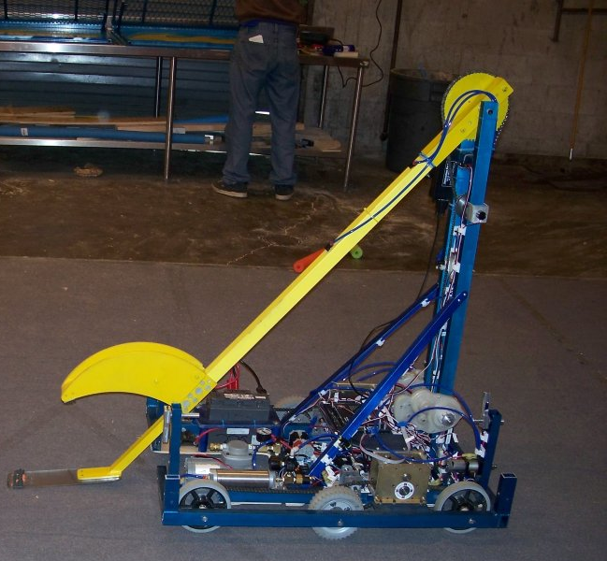
Single Jointed arms
330 is King
Copy them!
RAMP videos on single joint arms
First
Second
COTS methods
Vexpro Versaframe and bearing blocks
Versaplanetary + 2 stages of chain reduction
Vexpro example

Slide 13
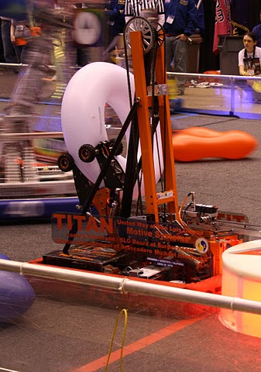
Double Jointed arms
973 2011 CAD
Download Here
Tradeoffs
Do you have an entire 2nd arm, or just a wrist?
Do you need 2nd joint angle constant (Virtual 4-bar)?
COTS methods
Vexpro Versaframe and bearing blocks (again) emulating our 2011 design
Or skip virtual 4-bar and versaplanetary the wrist.

Slide 14
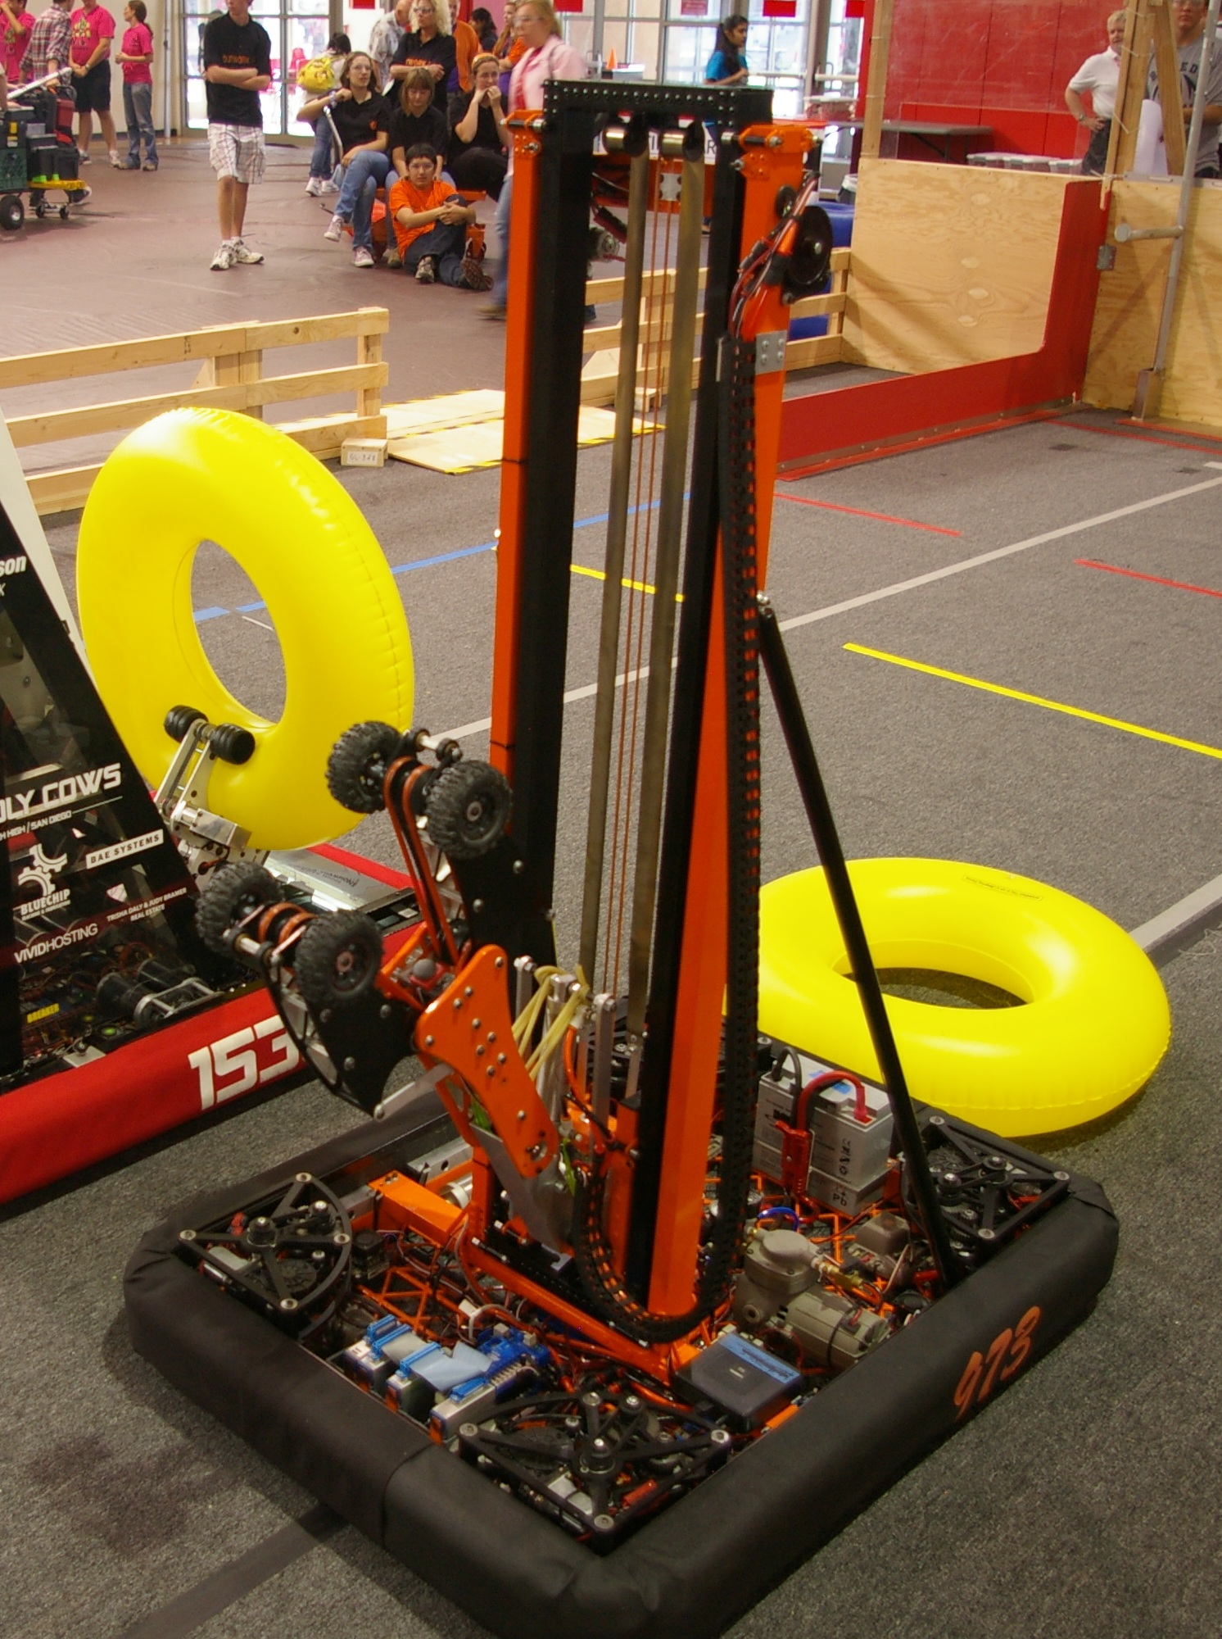
Elevators
Single Stage versus Double
Single far easier, but only lifts ~80% of robot height.
Nice to counterbalance by constant force springs
Advantages of elevator
When sizing for same % of stall, elevator will lift same load faster.
Able to raise very high without extending out
Cots solutions
Roller kits available from competitionrobotproducts.com and from vexpro.
Bunch of RAMP Videos on Elevators
1, 2, 3, 4

Slide 15
Mechanical Tips for all
Power transmission
Tensioning
Protect versaplanetaries by 1-2 stages of further reduction for big arms (and use “strong” output stages 5,7,9)
Hardstops (and hardstop zeroing)
Sensor Placement (designed in)
Control
Ensure sensor resolution makes sense
Gearing slower is exponentially easier to control (likely just needs P and maybe feed forward). Only gear faster if your team can control it.
Preset positions are good, but also have ability to manually control in case things happen.

Slide 16
Shooters
Allen Gregory - 3847

Slide 17
Shooter Variables
Trajectory
Velocity
Launch angle
Vertical (elevation)
Horizontal (azimuth)
Spin
Fixed vs. Adjustable
Will the driver/robot be able to adjust these mid match?
Hold as many of the variables fixed as you can while accomplishing your chosen game strategy
If they can’t be constant, attempt to limit them to as few possible positions as you can instead of making them infinitely variable.
Prototyping will allow you to find the proper setting per game object but intuition/prior knowledge/common sense will help as well

Slide 18
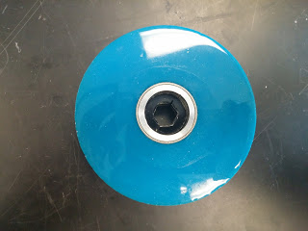
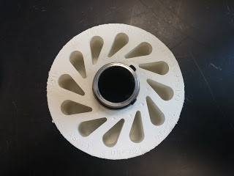
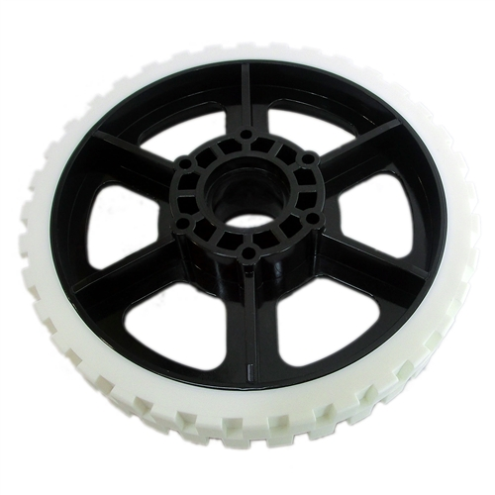
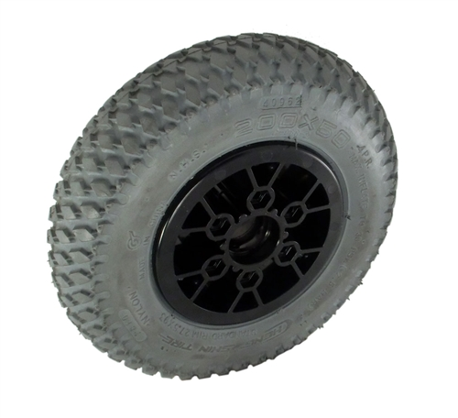
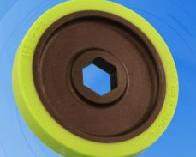
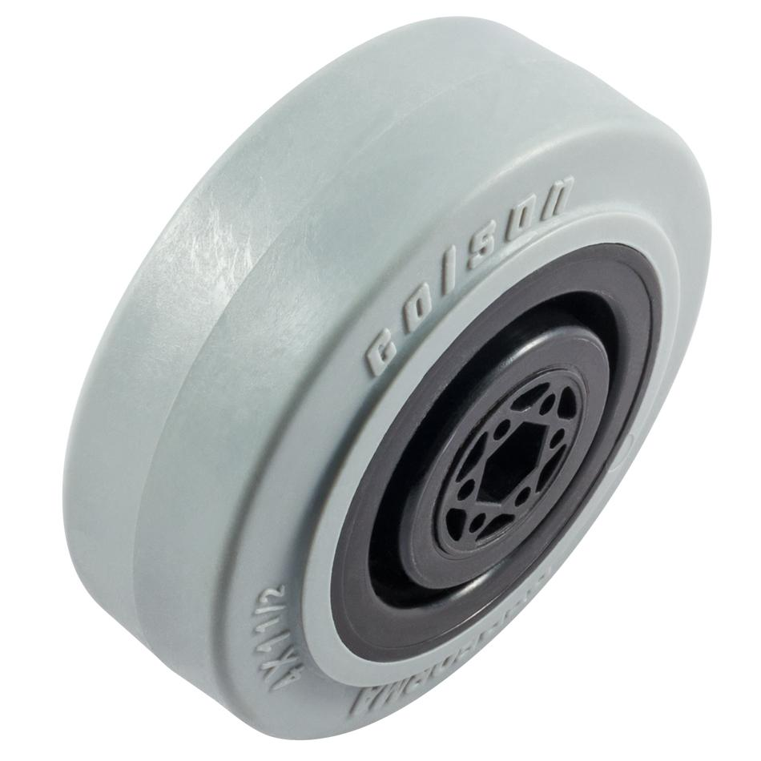
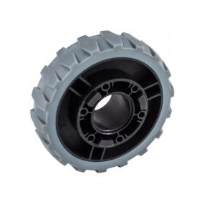
Shooter Wheels
Identify Variables and choose between options
Have a lot of different wheel options to prototype with
Wheel Variables
Size - diameter, width, weight, etc
Interaction with game object - friction, damage, etc
Wear
Cost
Other Variables
Pressure (if pneumatic)
Modifications (cutting grooves, paint on urethane, etc)
Pay attention to the opposite wall

Slide 19
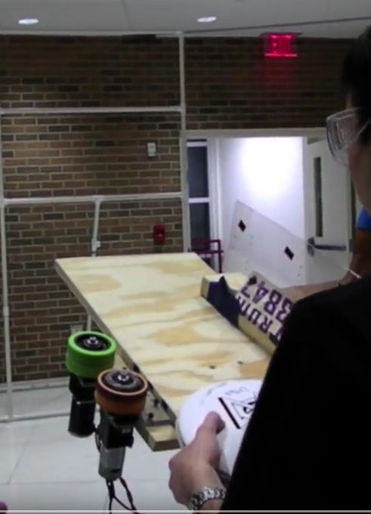
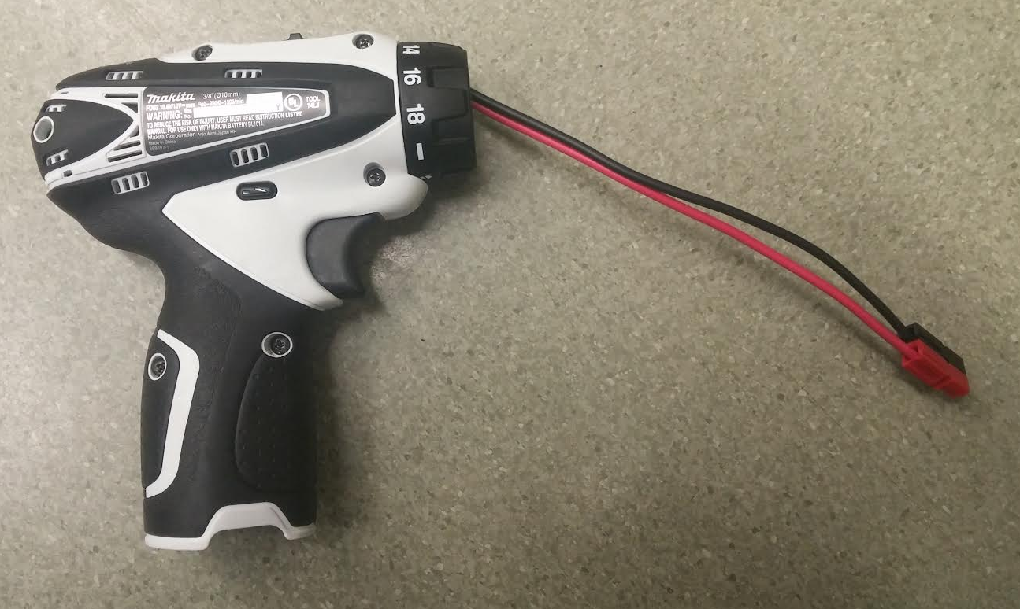
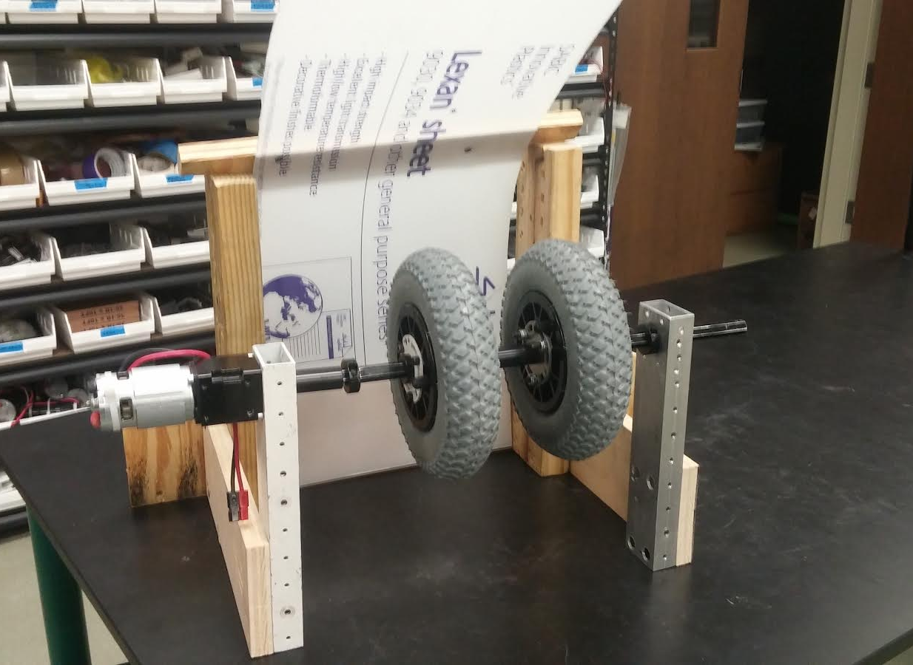
Rough Prototypes
How we get shooting quickly
Drills and Versaplanetary Gearboxes
Convert 12v Drills to “Flightsticks” to power motors

Slide 20
Shooter Notes
Consistency
Rigid assembly
Consistent loading from collector to shooter
Consistent speed
Consistent wear and maintenance
Consistent game piece (or adjust to the game piece)
Plan to Iterate
The real shooter will always be a bit different from the prototype
Plan to be able to make adjustments to angles, compression, etc to “Dial In” in your shooter.
Adjust one variable at a time
Analyze Results
Hi speed video (120fps+) is a great way to look at what is happening in your shooter

Slide 21
Resources
Improvised hubs for hubless wheels
http://blog.spectrum3847.org/2015/07/improvised-hubs-for-mcmaster-carr-wheels.html

